Slide 1
The Data Mine: Summer Cohort ‘23

Slide 2
Ground Rules for Virtual Meetings
Add pronouns to your name
Mute when you’re not talking
[if use auto-generated captions] when you use spoken English, check captions for accuracy
Question? Comment? Please use the “raise hand” feature on Zoom
Be patient. We have multiple communication modality preferences.

Slide 3
What is The Data Mine exactly?

Slide 4
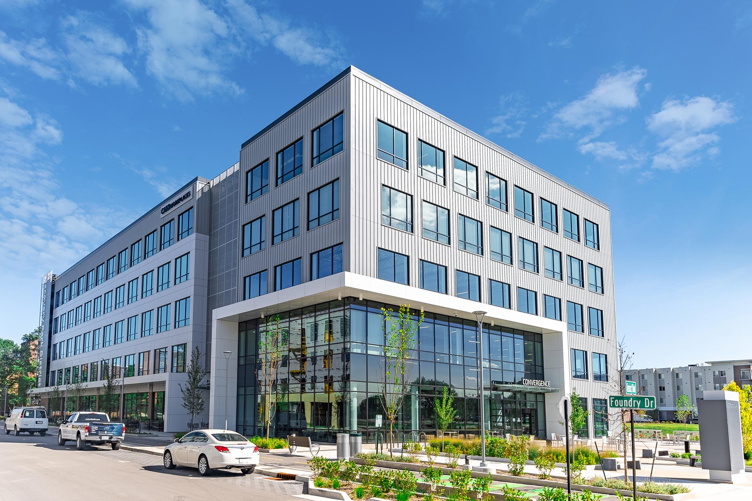
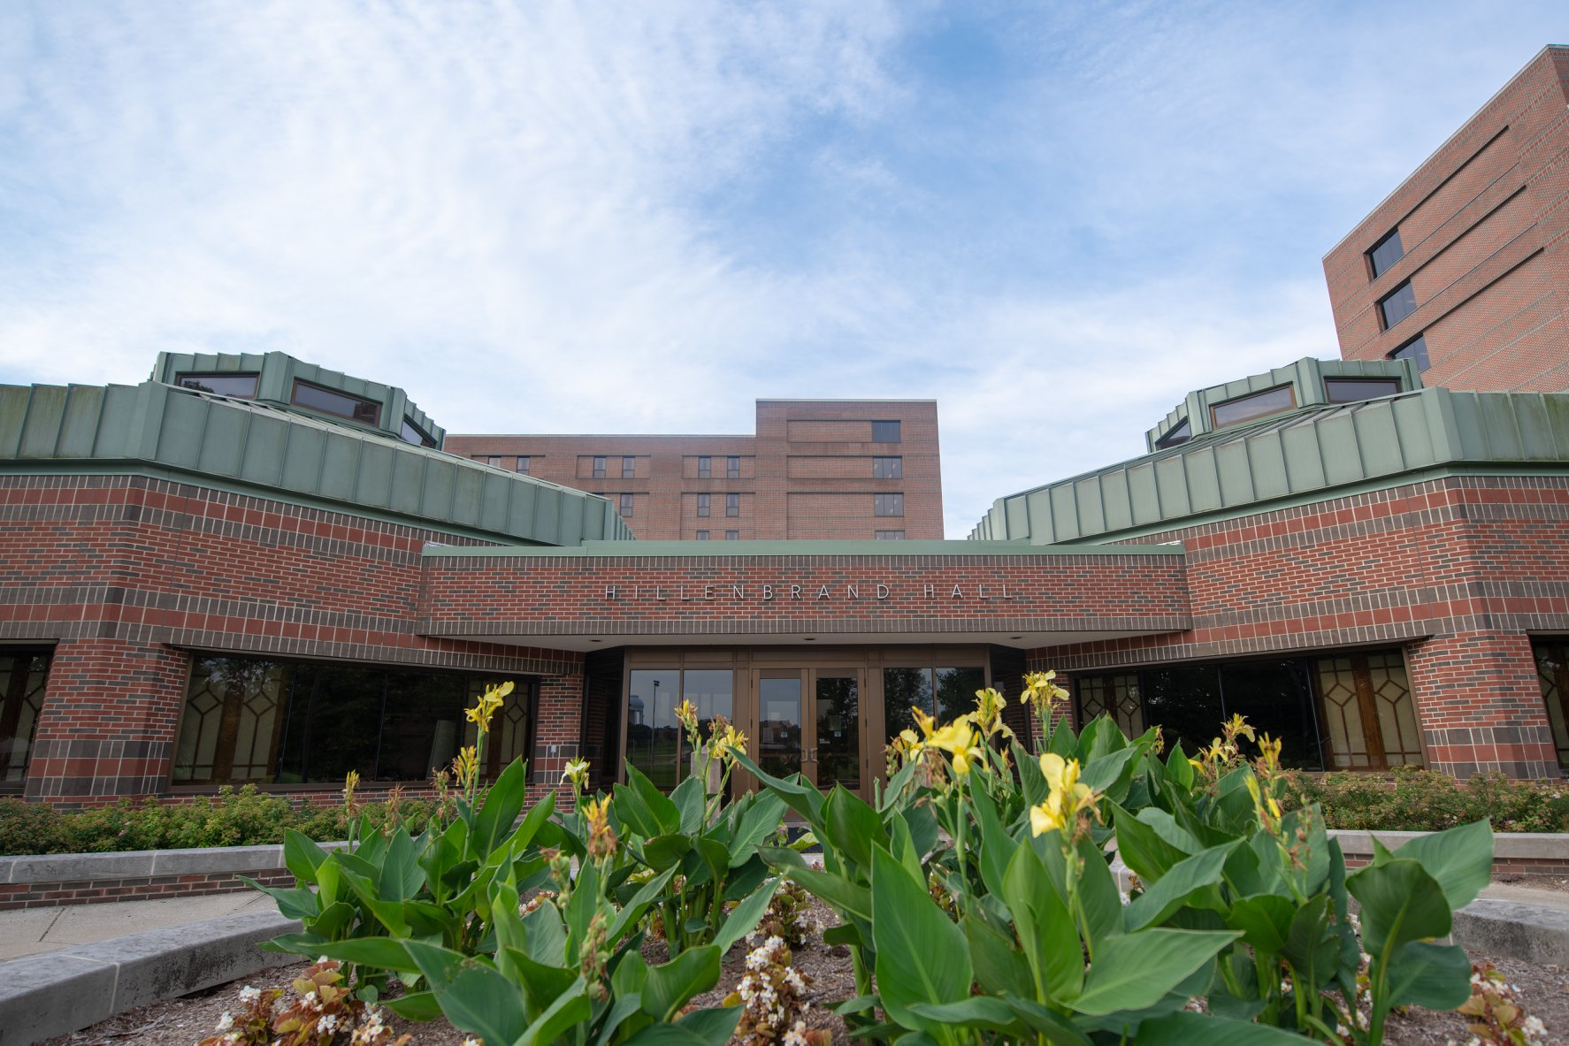
Overview of The Data Mine
Living, learning community (many students live in Hillenbrand Hall)
All backgrounds and majors welcome
Supportive, active learning environment
Learn data science skills in HPC, Python, R, SQL; no lectures; all project based
Data sets at modern complexity and size, from all disciplines
60 Corporate Partners, offering 75 projects, during 2022-23 academic year
~ 1300 total for fall 2022 with ~100 graduate students and ~100 students from MSIs
133 unique majors represented by students
Convergence Center
Hillenbrand Hall

Slide 5
TDM Cohorts
National Data Mine Network
Bringing TDM experience to MSIs
Indiana Data Mine
Establishing regional hubs with a strong focus on Indiana companies
Black Studies Data Mine
Combining Black Studies and Data Science to Drive Policy Changes
DEAF PODS
Bringing TDM experience to the deaf community in the United States

Slide 6
DEVELOPING experiential accessible framework for partnerships and opportunities in data science (for the deaf community) ['Deaf pods']
NSF GRANT #H473
Notes:
SDSS 2022: Wednesday, June 8

Slide 7
Corporate Partner Cohort
Opportunity to work on real-world problems with corporate partners
Hands-on, project-based experience
Very student-led
“In an industry, having data fluency is very important… They [students] are going to be able to use these skills when they go into industry. They’re going to really have some expertise from day 1 when they get hired with the company. ” – Brad Fruth from Beck’s
We will discuss more about this tomorrow morning.

Slide 8
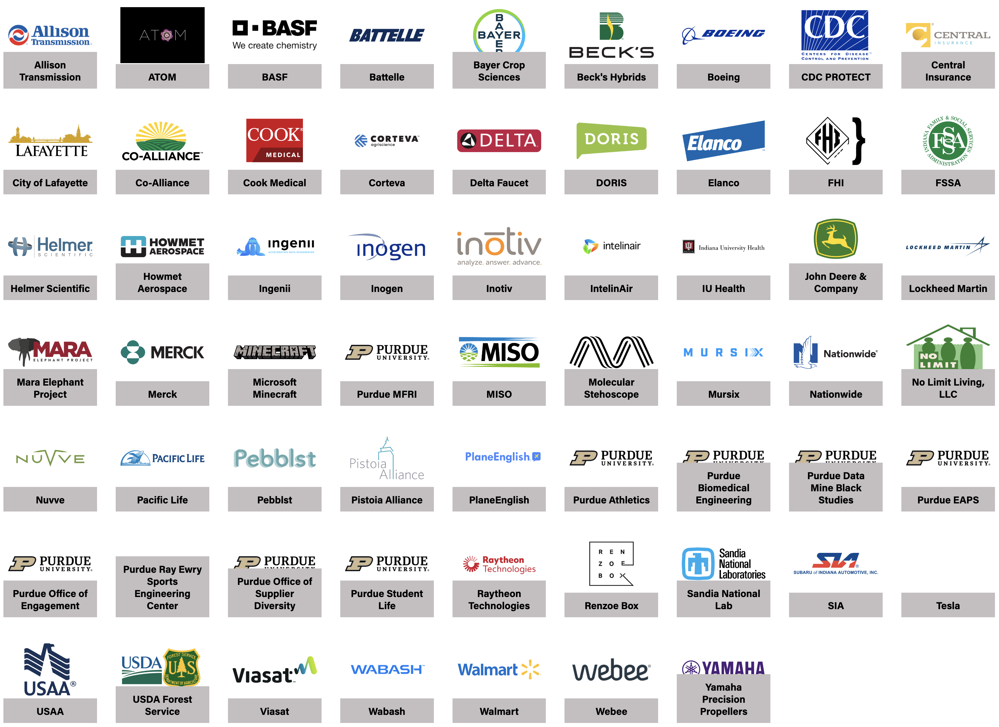
2022 – 2023 Corporate Partners
80 corporate partners teams in 2022-2023

Slide 9
We are here to support you!

Slide 10

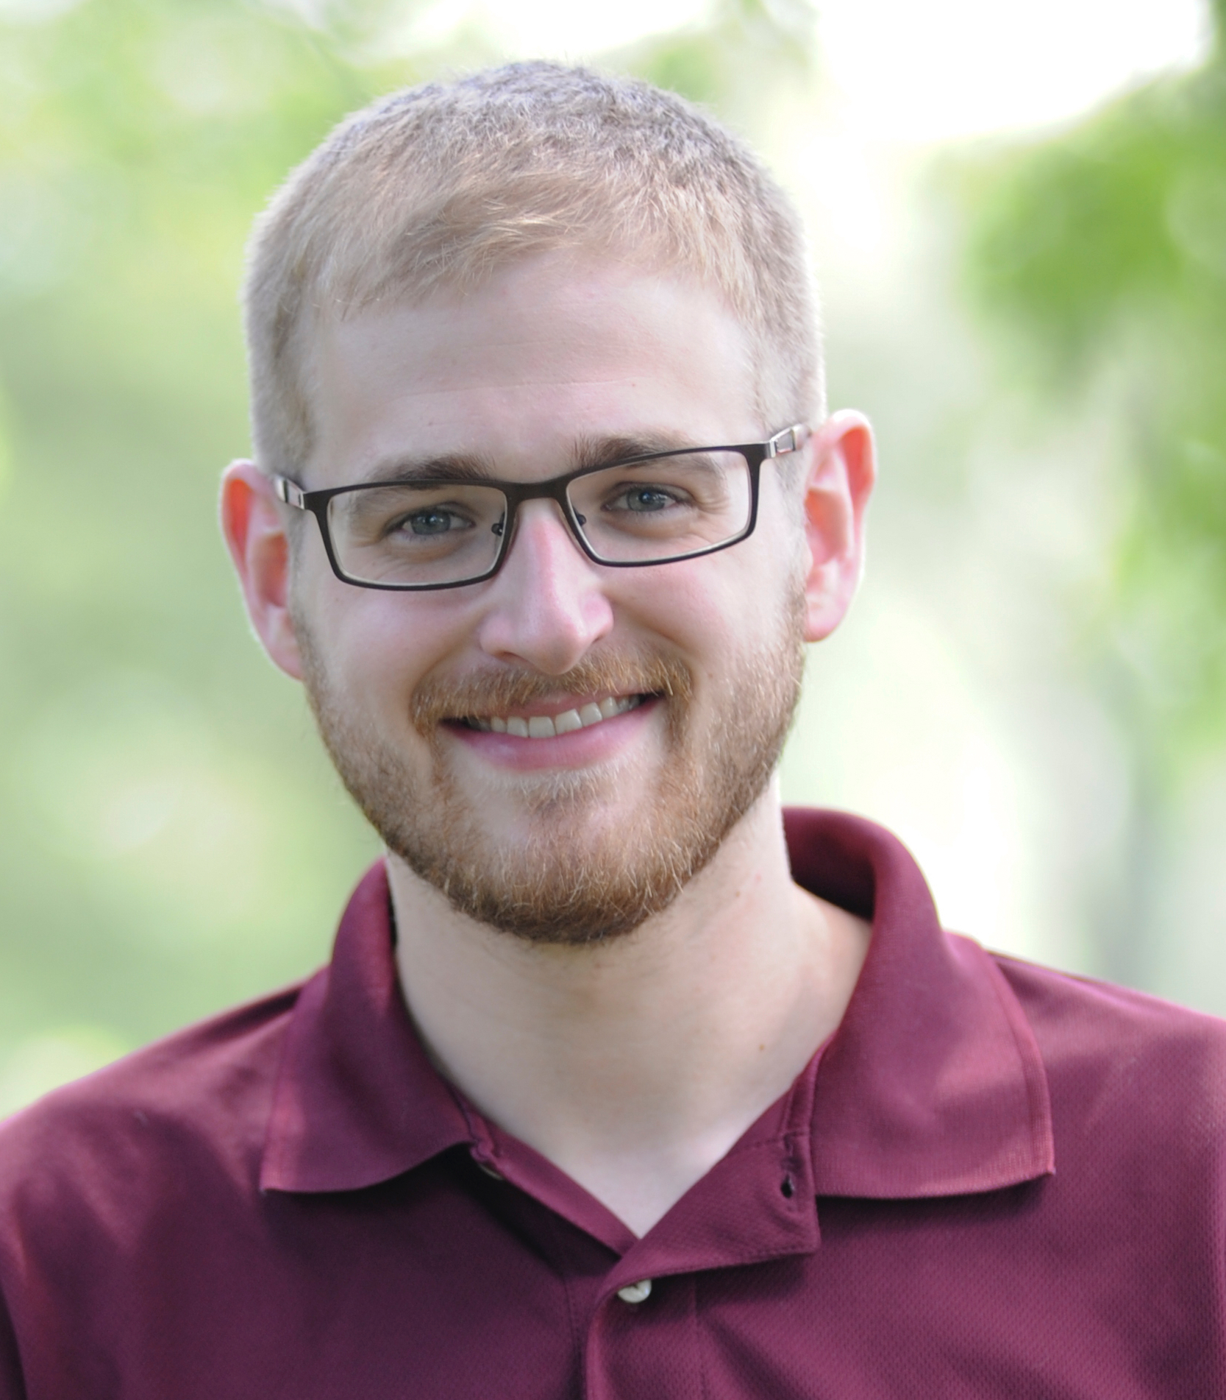
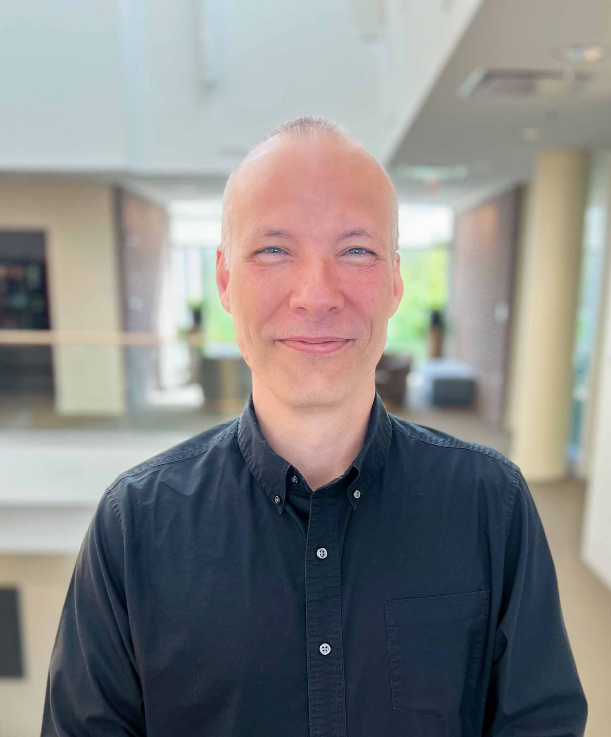
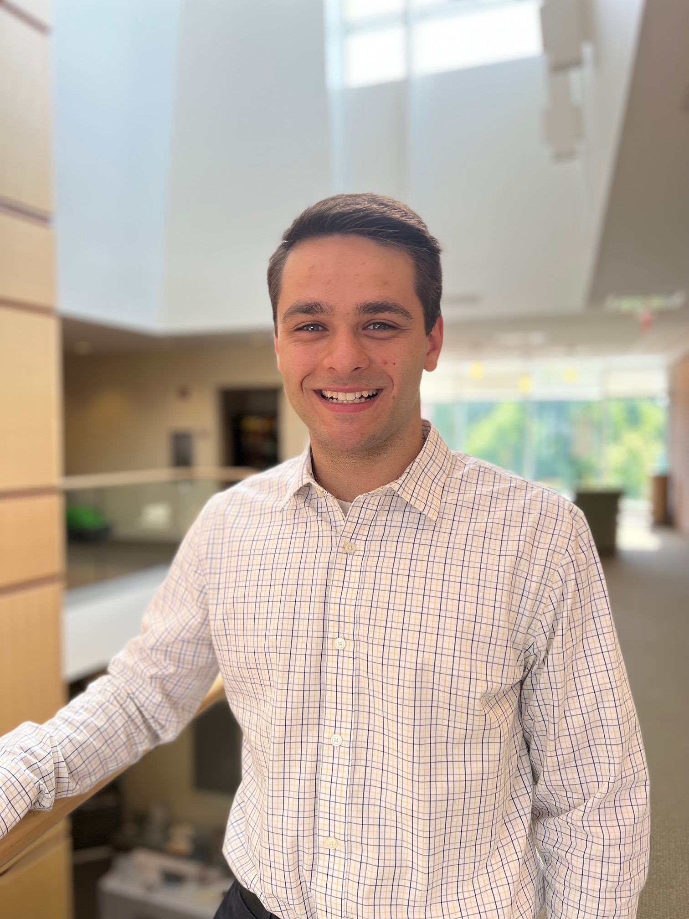
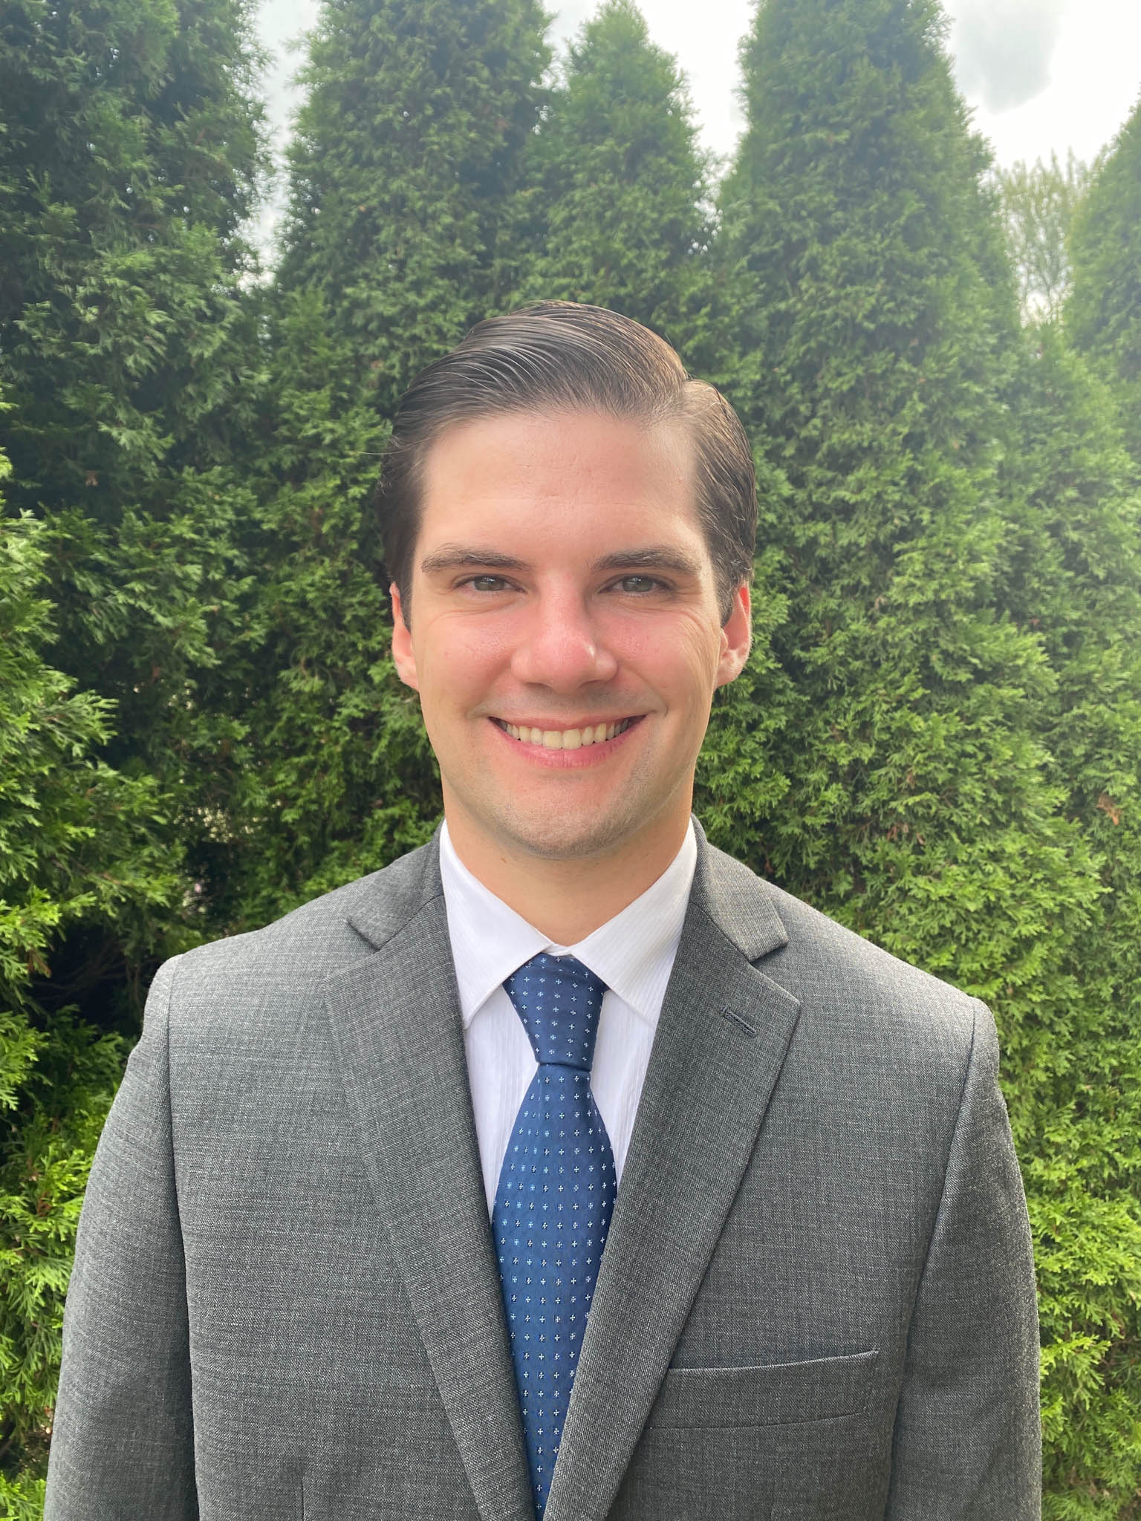
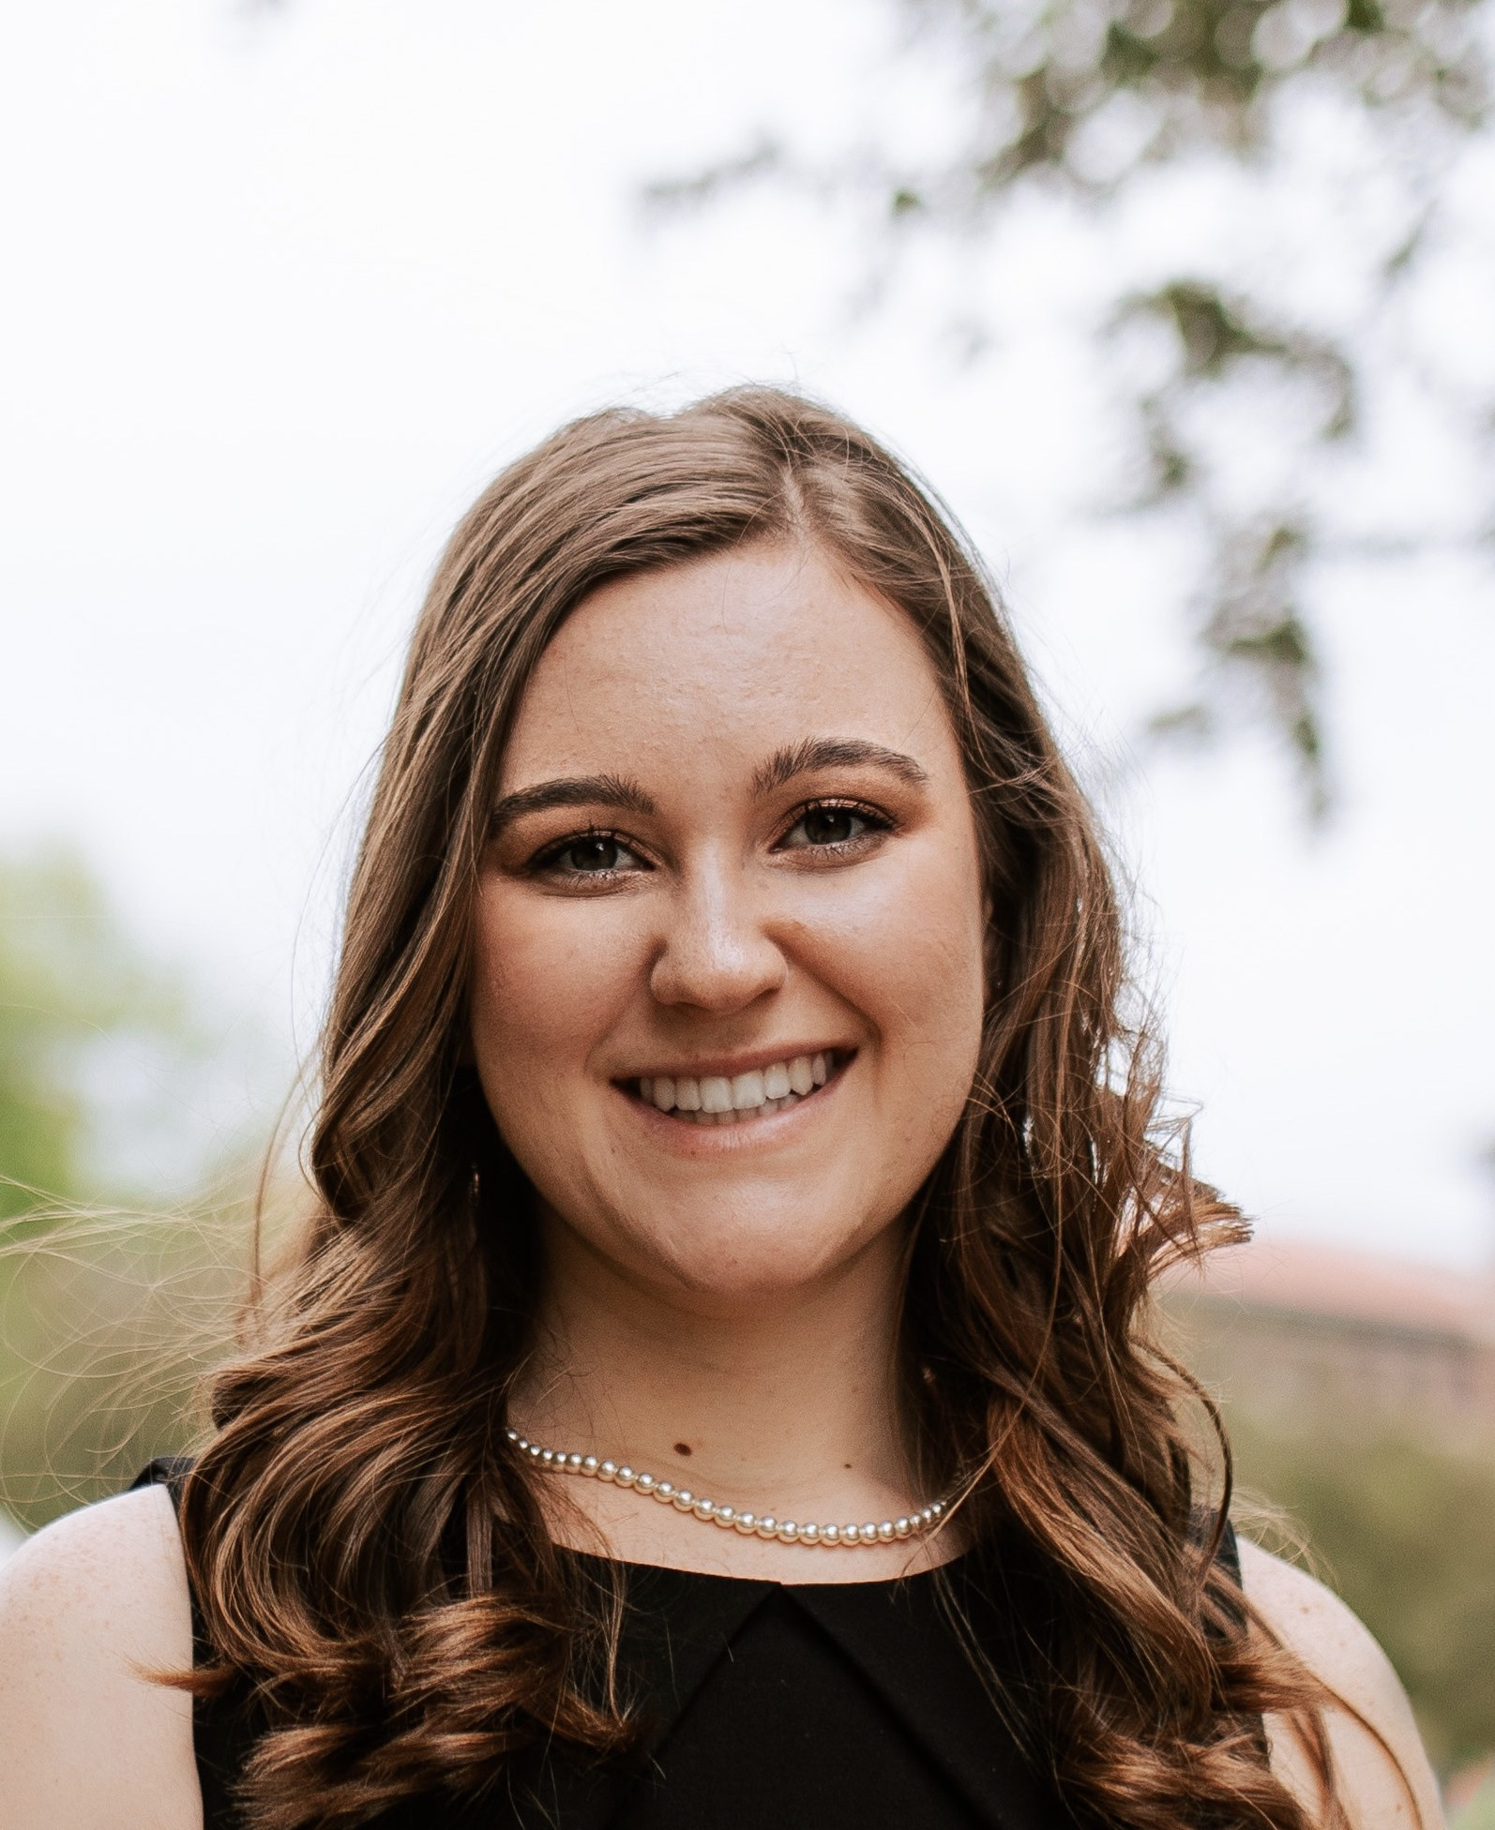
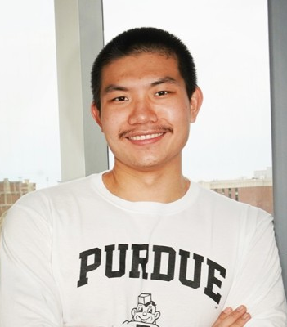
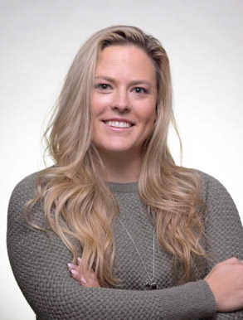
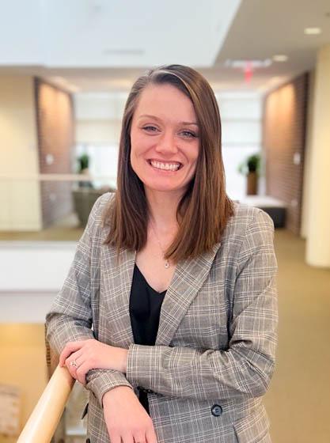
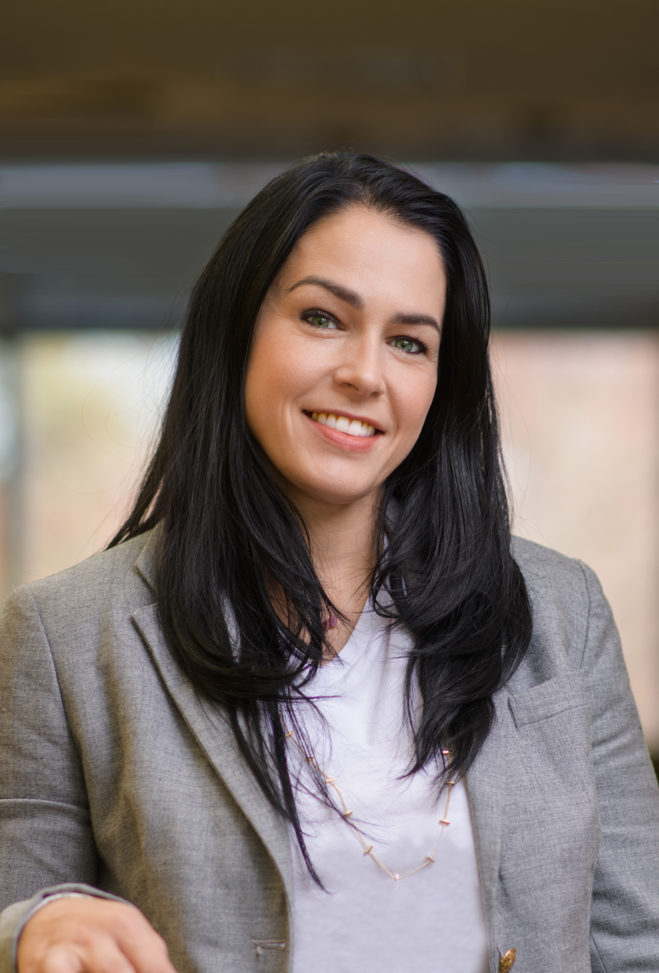
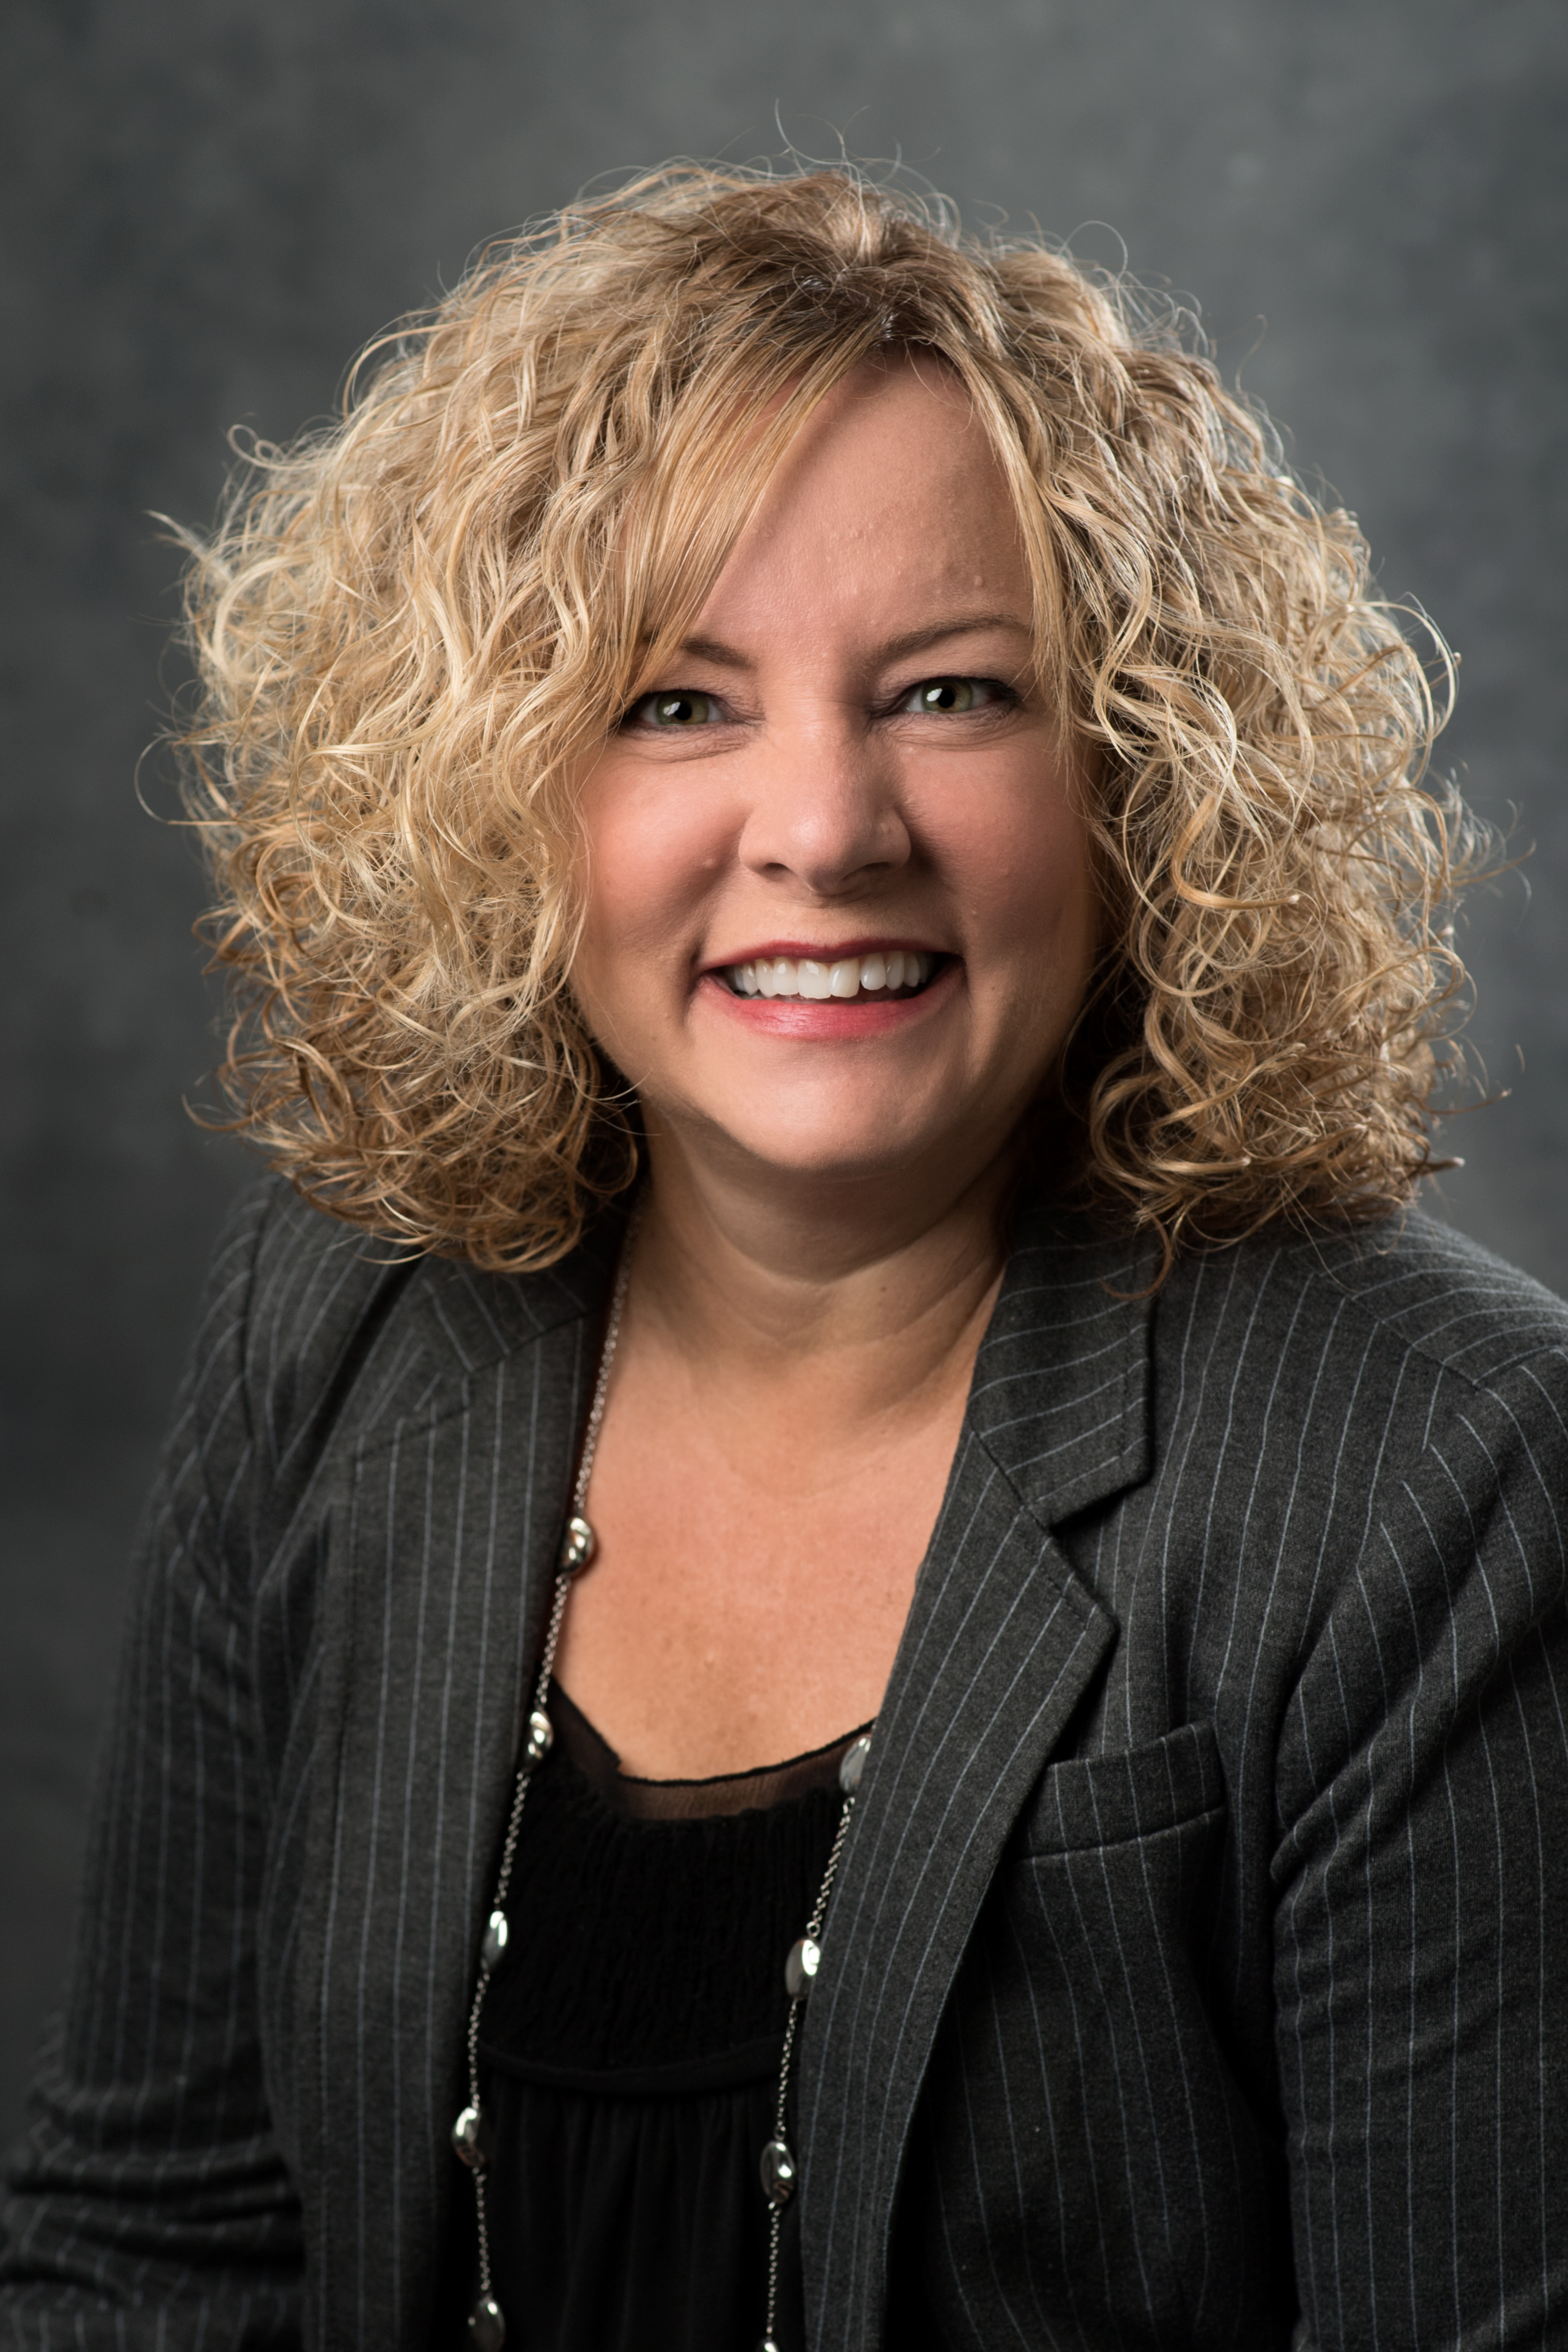
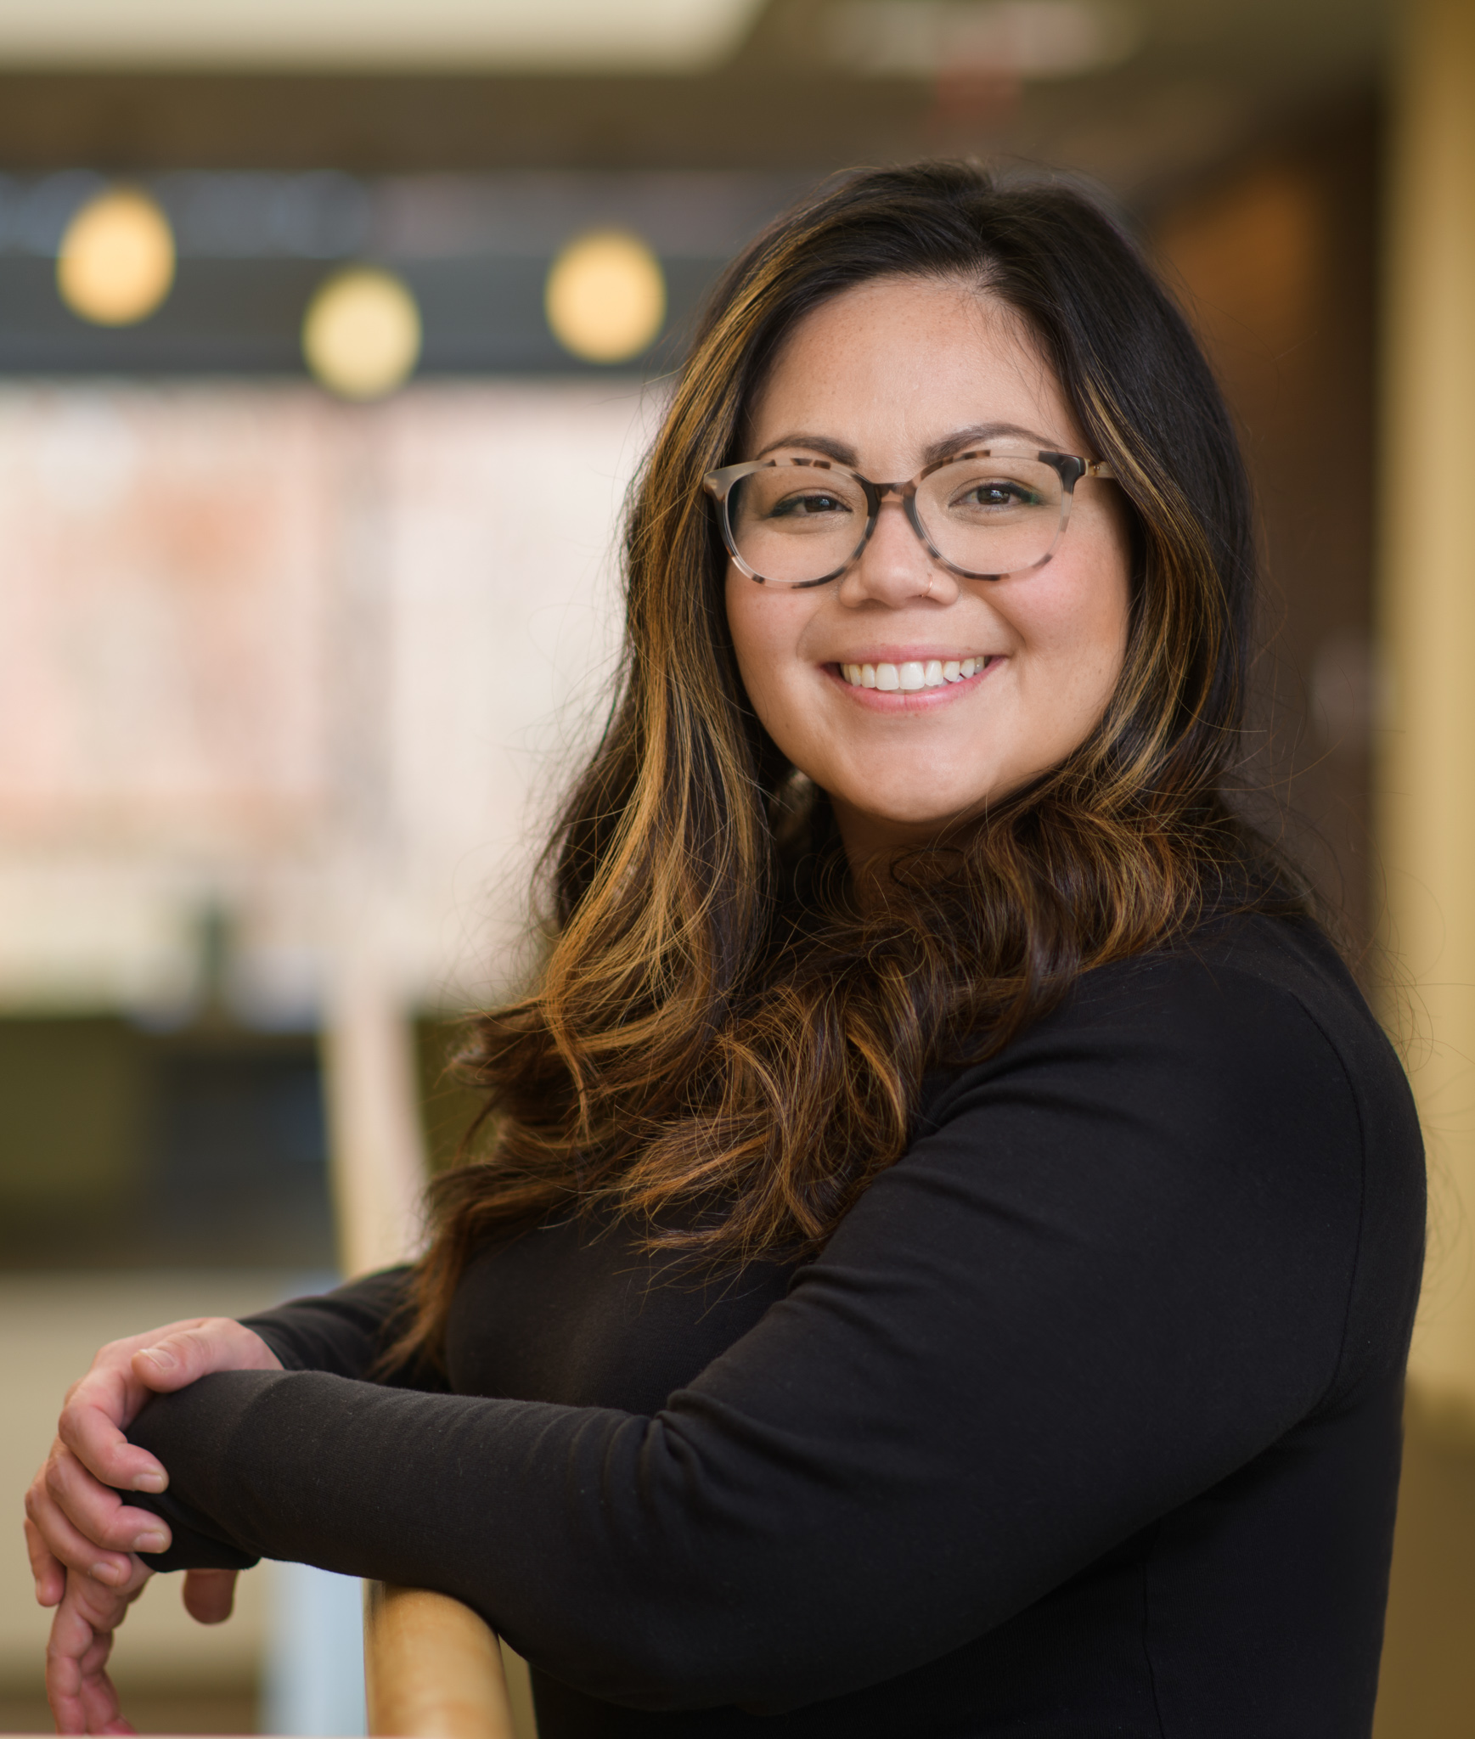
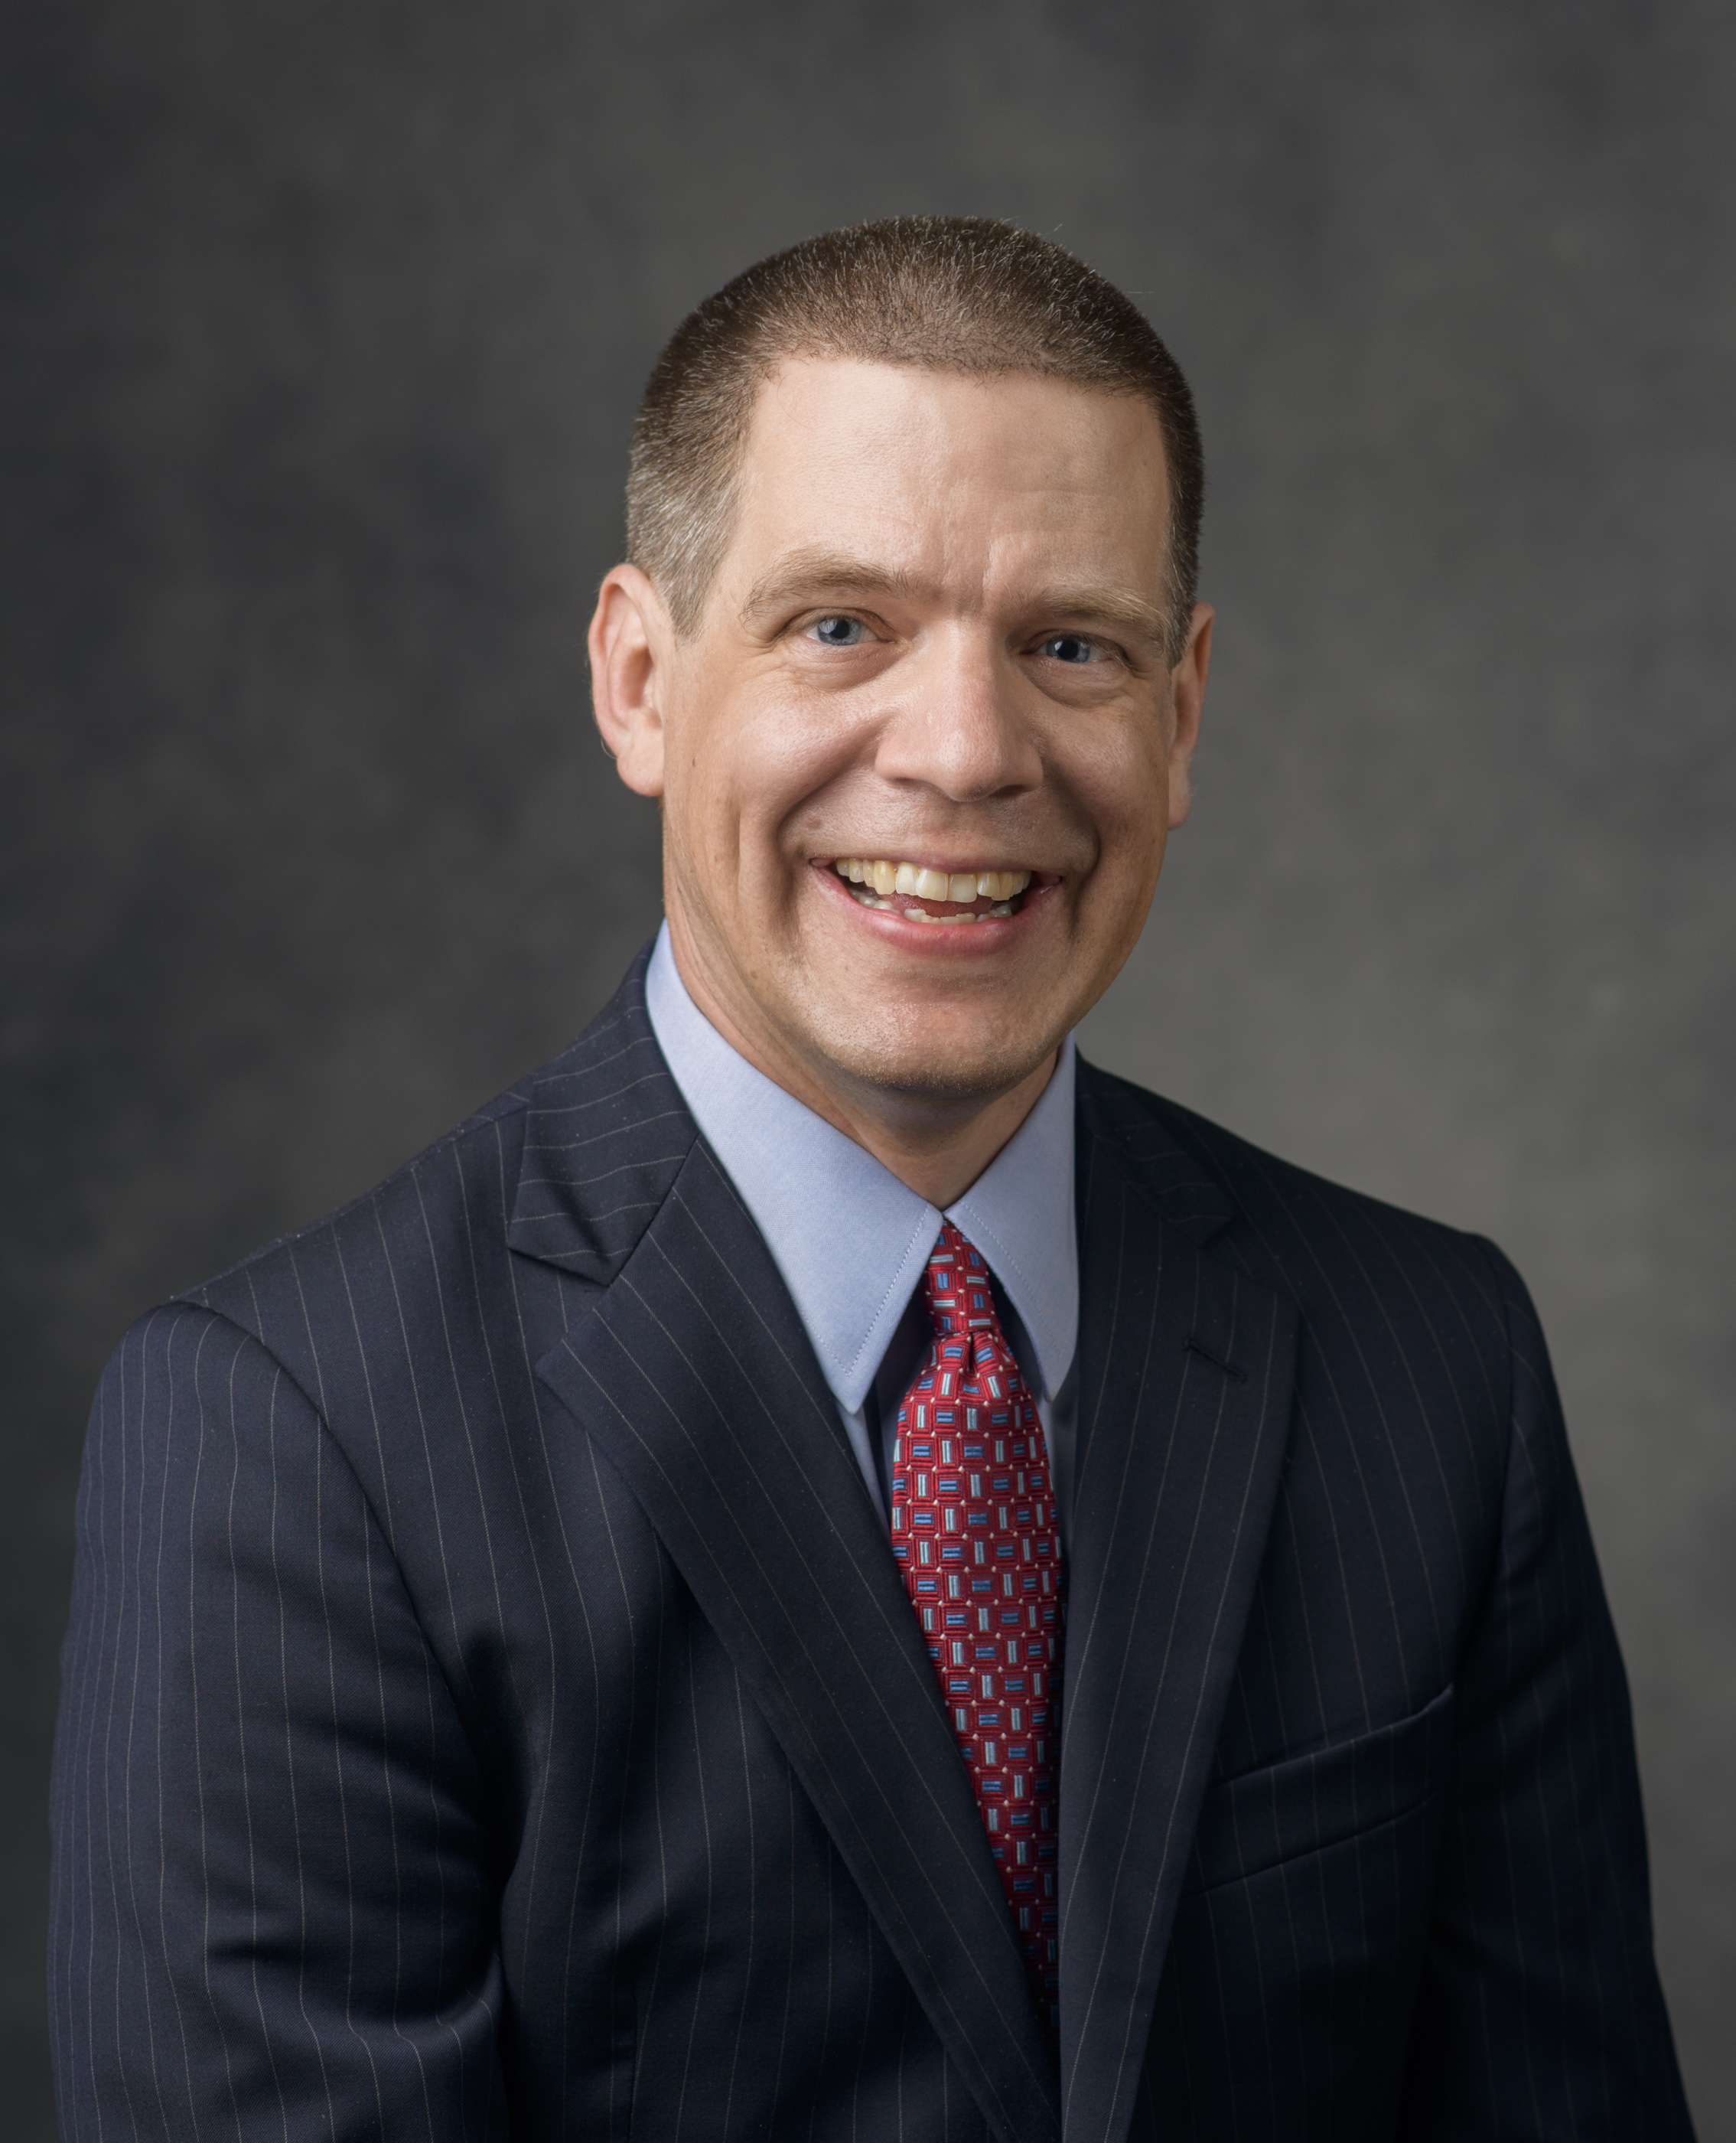
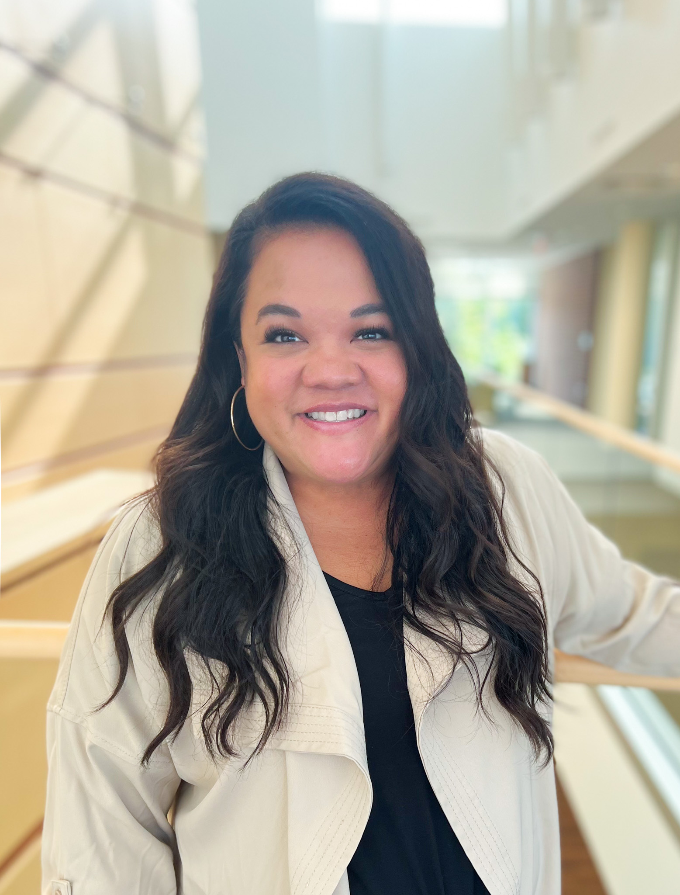
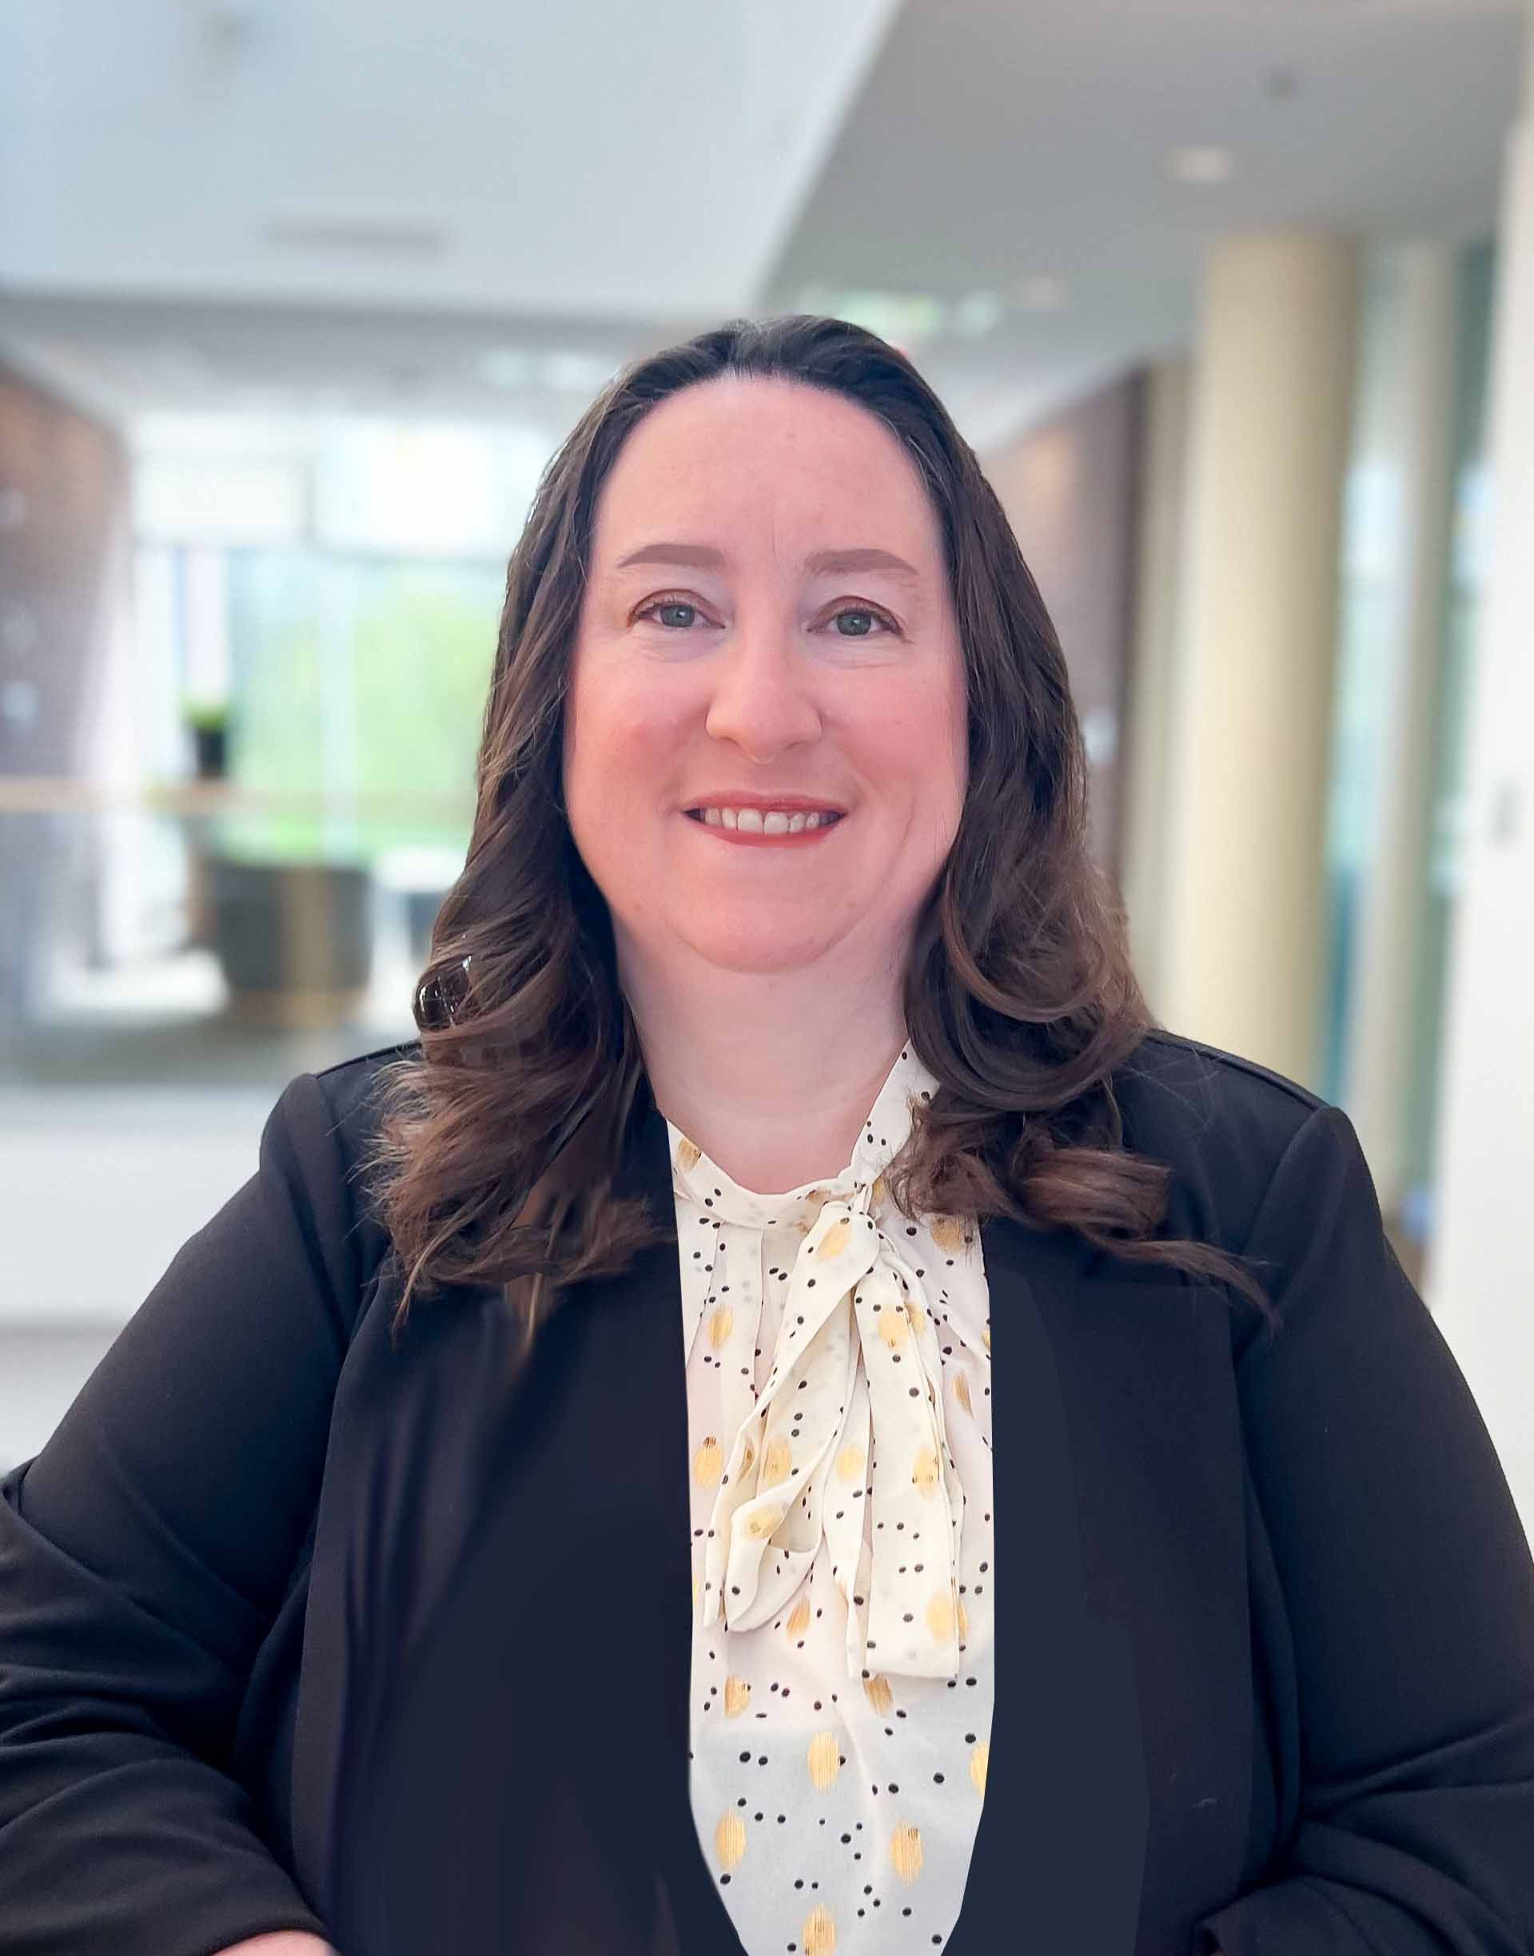
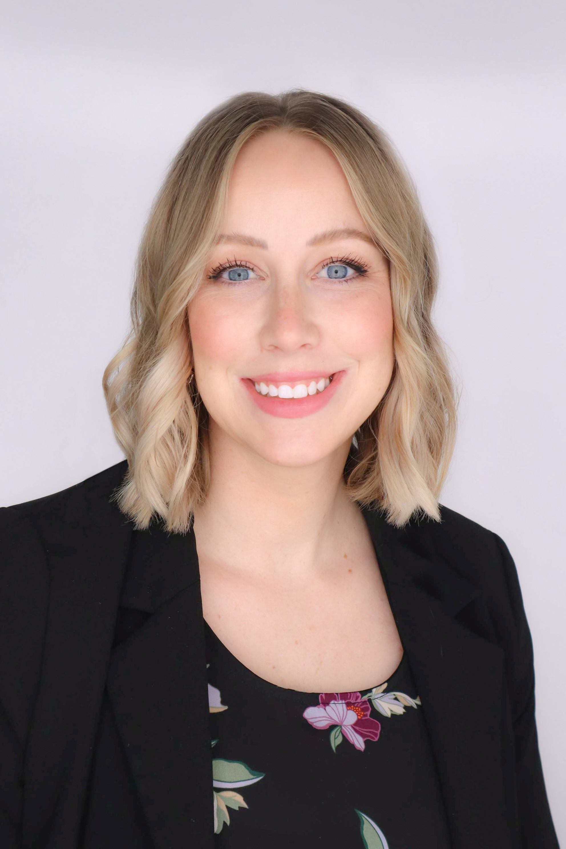
TDM Staff
Data Science Team
Academic
Outreach Team
Corporate Partner Team
We all share the email:
datamine@purdue.edu
Operations Team
Lone Wolves

Slide 11
Meet Your TA
Nina Tran
ASL Education Center, 5-Star Interpreting
Sammy Lisanework
Nationwide, DEAFCYBERCON
Lynley Arnholt
FSSA
Note: All TAs will sign all NDAs for all the projects.

Slide 12
At this point…
Signed the Direct Hire form from Purdue Business Center
Know which project you’re assigned to
Know your teammates are
Identified your mentor meeting times
Understand the generic scope of your assigned project

Slide 13
In progress…
Get your Purdue and ACCESS accounts set up
Gradescope, meeting invites, Microsoft Teams, emails, etc.
Identify 15 hours of collaborative times with your team
Create a team contract
Sign the NDA for your project
Receive meeting invites for mentor meetings by next week

Slide 14
Expectations
Submission
Timesheet Justification due Sunday at 11:59 PM
Allocate 30 hours a week
Sprint Report due Friday at 11:59 PM
Pre and Post survey
Poster Deliverable (deliverables may vary)
No late work accepted
Meetings
Show up for all mentor meetings
Regular team collaborative meetings
Last mentor meeting every week:
Create slides consisting of your updates and present to your mentor(s)
Show up to meetings prepared to take notes and ask questions
Student-led

Slide 15
Expectations Cont’
Communication
Constantly check your Purdue email and Microsoft Teams
Email & Teams are our primary mode of communication
Be in constant contact with your TA, teammates, mentor(s)
Be proactive for help
The earlier you let us know, the easier we can help you
Not OK to stop participating if the content gets difficult

Slide 16
Let’s Keep Each Other Accountable
Miss two meetings in row with no communication or unexcused
First meeting to discuss and check in to see how we can best help
After the first meeting, miss a meeting for the third time
We will meet with you to discuss about your participation in the program
Your team contract is important as it’s a way to keep yourself and your teammates accountable.

Slide 17
In Summary
Student-led
Communication is the key
We all are here to support you!
All contents are in the Examples Book:
https://the-examples-book.com/deaf-pods/students/intro

Slide 18
Questions?

